Slide 1

INDIAN INSTITUTE OF TECHNOLOGY, KHARAGPUR
DEPARTMENT OF INDUSTRIAL AND SYSTEMS ENGINEERING
Spring Semester – 2022
IM39003: OPTIMISATION AND HEURISTIC METHODS PROJECT
Optimizing bank lending decisions using meta heuristics
By:
Kethavath Pavan Chandra
19IM30012

Slide 2
Contents
Problem statement
Aim
Loan characteristics
Chromosome Encoding
Fitness function
Data Overview
Parameters chosen
Approach for Genetic algorithm
Approach for Simulated annealing
Approach for Amalgamation
Results:
Discussion:
3
4
4
5
5
6
6
7
9
10
12
14

Slide 3
Problem Statement
Given a scenario where credit crunch has occurred and there is a need for the bank to come up with an intelligent model that can carefully organize the lending decision in a highly competitive environment where all the applicants of the loan are eligible to get the desired loans.

Slide 4
Aim
Develop a metaheuristic that can come up with an efficient lending decision
Maximize the bank Profit
Minimize the crediting cost
Loan Characteristics
Bank
Transaction Cost (T)
Institution’s deposit (D)
Reserved ratio (K)
Transaction rate (r_{T})
Deposit interest rate (r_{D})
Customer
Loan Size (L)
Loan Interest Rate (r_{L})
Expected Loan Loss (ƛ)

Slide 5
Chromosome Encoding:
Binary string whose length = number of loan applicants
Fitness Function
F = Revenue + Transaction Cost (⍵) - cost of demand deposit (𝛃) - Total Loss
Where, Revenue=sum(r_{L}L-ƛ)
Transactional Cost= sum(r_{T}T)
T=(1-K)D-L[i]
Beta = r_{D}D
Total Loss= sum( ƛ)
*Above summations are over only the customers who have received loan

Slide 6
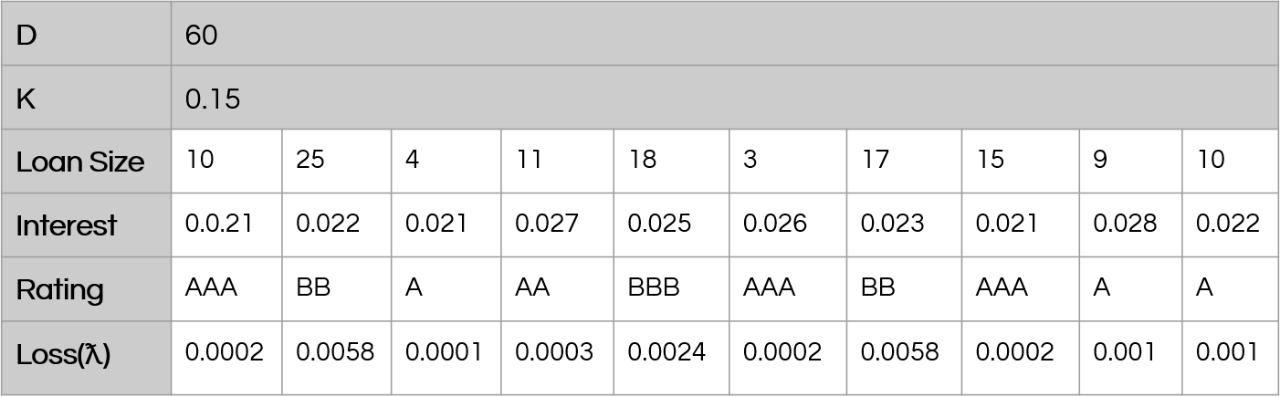
Data Overview
Parameters chosen:
Population Size: 10
Cross Over Probability: 0.8
Mutation Probability: 0.006
Max Iterations: 50

Slide 7
Approach for Genetic algorithm:
Steps:
Initialisation
Roulette wheel selection
Crossover
Mutation
Stopping criteria
My submission contains 3 metaheuristic algorithms
Genetic Algorithm
Simulated Annealing
Amalgamation of Genetic algorithm and Simulated annealing
Approach for Genetic algorithm:
Steps:
Initialisation
Roulette wheel selection
Crossover
Mutation
Stopping criteria

Slide 8
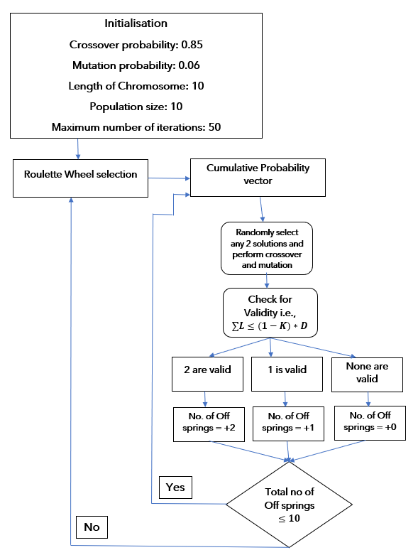
Flow Chart: At any iteration

Slide 9
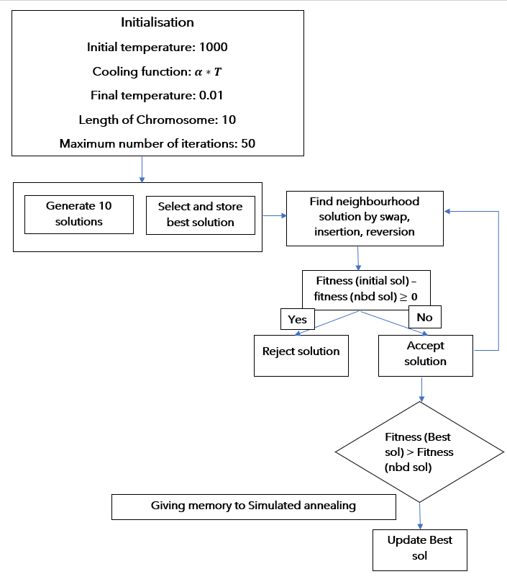
Approach for Simulated annealing:
Steps:
Initialization
Calculate fitness value and find the best among them
Generate neighborhood solution
Acceptance using acceptance probability
Stopping criteria
Flow Chart: At any temperature

Slide 10
Approach for Amalgamation:
I have chosen Simulated annealing along with Genetic algorithm for amalgamation. In the process of genetic algorithm, I have tried to incorporate simulated annealing. Which is explained below.
After the crossover and mutation each of the off springs obtained undergo simulated annealing before they go for validation of loan size this would make the local search more rigorous and increase the chance to for global search. Finally, we get a set of off springs which are feasible and undergone both GA and SA.

Slide 11
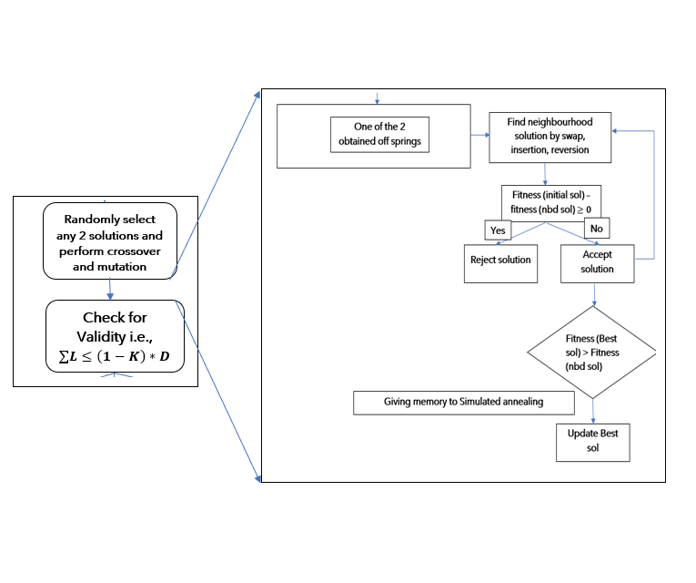
Flow chart: At any iteration and at one temperature
Change in the algorithm
Flow chart: At any iteration and at one temperature

Slide 12
Flow chart: At any iteration and at one temperature
Results:
Hence the optimal solution is:
Total sanctioned amount = 47, fitness value = 6.8476
Bank has lent a loan amount of 10 to customer 1
Bank has lent a loan amount of 4 to customer 3
Bank has lent a loan amount of 11 to customer 4
Bank has lent a loan amount of 3 to customer 6
Bank has lent a loan amount of 9 to customer 9
Bank has lent a loan amount of 10 to customer 10
Fitness values in each case:
Replication number | Genetic algorithm | Simulated Annealing | Amalgamation
1 | 5.522000 | 5.928800 | 6.541800
2 | 5.778600 | 4.708000 | 6.541800
3 | 5.729200 | 6.847600 | 6.541800
4 | 5.514000 | 5.820000 | 5.115800
5 | 5.563400 | 5.978200 | 6.541800
Average | 5.6214 | 5.8565 | 6.2566

Slide 13
Flow chart: At any iteration and at one temperature
Discussion:
Looking into the above table it can easily concluded that Amalgamation gives best results in most of the executions.
As mentioned earlier since a memory is added to simulated annealing and also initial solution is considered the best among ten randomly generated solutions. This might be the reason why the results of Simulated annealing are better than that of Genetic algorithm.
It is quite obvious that an effective algorithm like genetic algorithm and updated simulated annealing would give best results.

